Slide 1
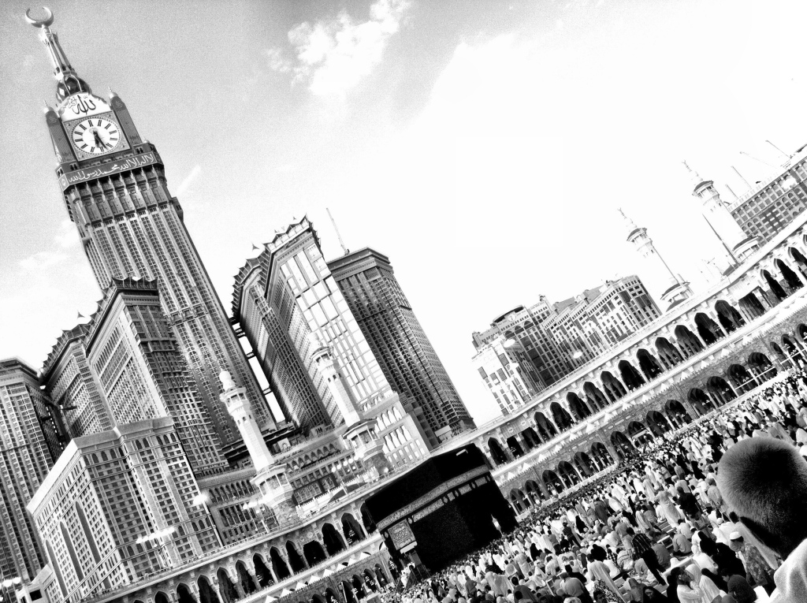


Slide 2


Unique Umrah One Stop Shop
The cheapest Umrah airline ticket
All paths are automatically checked (Dynamic Route selection):
1- Origin - Jeddah | Madina - Origin
2- Origin - Madina | Jeddah - Origin
3- Origin - Jeddah Round trip
4- Origin - Madina Round trip

Slide 3
Unique Umrah One Stop Shop

Slide 4
All paths are automatically checked
Smart Route selection
The Cheapest
Umrah Airline Ticket
1- Origin - Jeddah | Madina - Origin
2- Origin - Madina | Jeddah - Origin
3- Origin - Jeddah Round trip
4- Origin - Madina Round trip

Slide 5
Up to 26% saving in a trip =192$

Slide 6
Average saving achieved 40% from sample searched cities

Slide 7
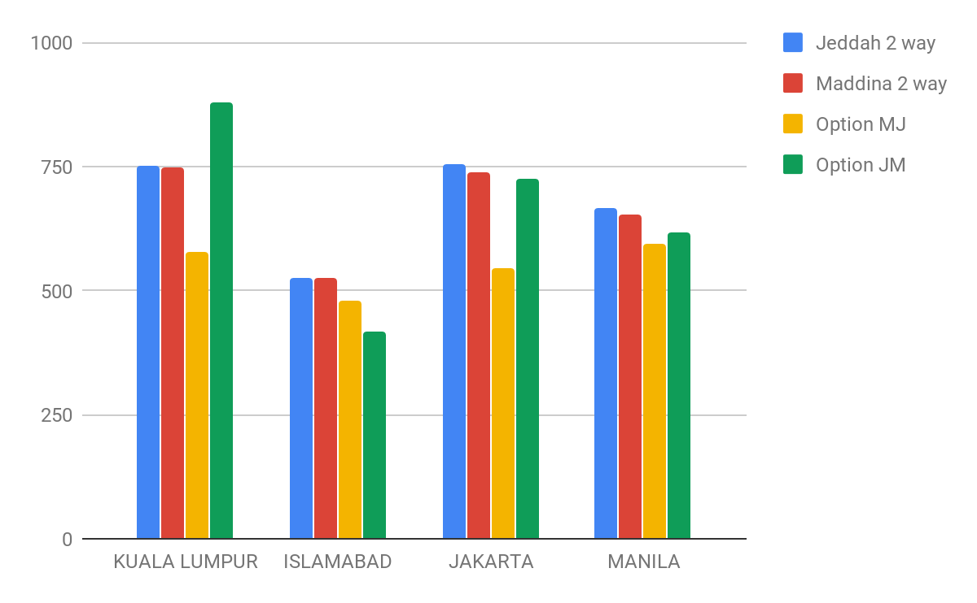
Cost Saving Results
Up to 26% saving in a trip (192$ saving).
Comparing Traditional ways of booking to smart booking approach

Slide 8


Revenue Model & Market Size
Booking affiliate % from each ticket booked through the platform through airline tickets aggregators.
A larger market size than Hajj reaching to 30 million yearly by 2030

Slide 9
Solving Case 5 in travel and accomodation challenge:
"Innovative ways to promote the Kingdom of Saudi Arabia for the Umrah season. Through Vision 2030, the Kingdom seeks to increase the number of pilgrims from 7 million pilgrims to more than 30 million pilgrims every year."
Q&A

Slide 10
Data for validation if needed
From | Jedda two way | Maddina Two way | Madina Arrival | Jeddah departure | Total (D+E) | Jeddah Arrival | Madina Departure | Total (G+H) | Saving Percentage
Cairo | $254 | 292 | 170 | 120 | 290 | 134 | 132 | 266
MANILA | 666 | 653 | 326 | 269 | 595 | 329 | 287 | 616 | -8.882082695
ALGIERS | 539 | 507 | 393 | 311 | 704 | 319 | 301 | 620
KUALA LUMPUR | 751 | 747 | 228 | 350 | 578 | 570 | 309 | 879 | -22.62382865
ISLAMABAD | 527 | 524 | 332 | 149 | 481 | 271 | 147 | 418 | -20.22900763
JAKARTA | 755 | 738 | 367 | 179 | 546 | 398 | 327 | 725 | -26.01626016
BAGHDAD | 538 | 459 | 317 | 145 | 462 | 305 | 231 | 536
KARACHI | 348 | 300 | 180 | 253 | 433 | 203 | 137 | 340
Mumbai | 382 | 379 | 210 | 167 | 377 | 206 | 157 | 363 | -4.221635884
New Delhi | 377 | 405 | 250 | 179 | 429 | 206 | 210 | 416

